Slide 1




VIDEO CONFERENCING TOOLS - ZOOM VS. MICROSOFT TEAMS
Presented By, Afiya Humaira – 222002112 Ibadullah Saif – 221002108 MD:Nahid bin Arafat – 222002031 Green University of Bangladesh
Presented To, Ms. Fatema Tuj Johora Lecturer Green University of Bangladesh

Slide 2
TABLE OF CONTENTS
01
02
03
04
05
06
Business Overview
Market Analysis
Sales and Marketing Plan
Here you could describe the topic of the section
Here you could describe the topic of the section
Here you could describe the topic of the section
Management Plan
Operating Plan
Financial Plan
Here you could describe the topic of the section
Here you could describe the topic of the section
Here you could describe the topic of the section

Slide 3


INTRODUCTION
What is Microsoft Teams ?
Cloud-based platform.
Seamless integration.
High-quality video and sound.
Comprehensive collaboration tools.
What is Zoom?
Cloud-based platform.
Seamless integration.
High-quality video and sound.
Comprehensive collaboration tools.

Slide 4
OVERVIEW OF THE COMPANIES
Zoom
Microsoft Teams
Founded: 2011 by Eric Yuan.
Focus: Primarily a video-first communication platform.
Target Market: Businesses of all sizes, educators, general consumers.
Launched: 2017 as part of Microsoft Office 365 suite.
Focus: Integrated team collaboration platform, combining video, chat, file-sharing, and productivity tools.
Target Market: Enterprises using Office 365, large organizations, and education sectors.

Slide 5
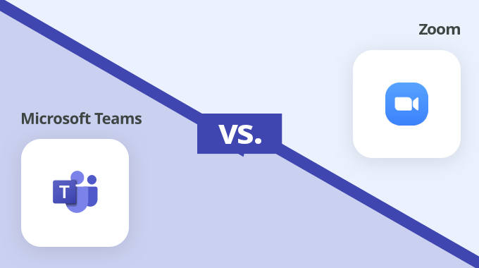
CORE FEATURES COMPARISON
Feature | Zoom | Microsoft Teams
Video Quality | HD video up to 1080p | 720p by default, customizable
User Capacity | Up to 1,000 participants | Up to 10,000 participants for webinars
Breakout Rooms | Yes, fully supported | Limited, but supported
Screen Sharing | Yes, with multiple users | Yes, with collaboration tools
File Sharing | Basic, through chat and cloud | Deep integration with OneDrive
Security | End-to-end encryption, waiting rooms | Encryption with advanced enterprise security
Integration | Works with popular apps like Google Drive, Slack | Integrated with Office 365 apps (Word, Excel, SharePoint)

Slide 6


USER EXPERIENCE
ZOOM
MICROSOFT TEAMS
Simple, intuitive interface, easy to use even for non-technical users.
Efficient for small to large-scale meetings, webinars, and conferences.
Offers specialized meeting tools like virtual backgrounds, noise suppression, and closed captions.
Comprehensive collaboration platform with chat, file sharing, and task management integrated.
Best suited for users who are already using Office 365 apps.
Some users report a steeper learning curve due to feature-rich interface.

Slide 7
SECURITY & PRIVACY
MICROSOFT TEAMS
ZOOM
Data protection with compliance for major standards like GDPR, HIPAA.
Early concerns over “Zoom-bombing” led to upgrades in security.
Offers multi-factor authentication, end-to-end encryption.
End-to-end encryption for paid users.
Built on Microsoft’s trusted security infrastructure.
Password-protected meetings and waiting room features.

Slide 8
MARKET ADOPTION & GROWTH
ZOOM
MICROSOFT TEAMS
Rapid growth during the COVID-19 pandemic.
Steady growth due to deep integration with Office 365.
Popular with educational institutions, small to medium businesses, and event organizers.
Widely adopted by enterprises, large organizations, and educational institutions.
Market Cap (2023): Approx. $22.9 billion.
Over 280 million daily active users in 2023.

Slide 9
PRICING MODELS
Zoom Pricing | Microsoft Teams Pricing
Free Plan | Free plan (limited features)
Pro: $14.99/month/host | Included in Office 365 subscription
Business: $19.99/month/host | Standalone licenses start at $5/user/month
Enterprise: Custom pricing | Enterprise-level pricing available

Slide 10
STRENGTHS & WEAKNESSES
Zoom Weaknesses
Zoom Strengths
Security issues in the past.
Lacks deeper productivity integration.
High-quality video and audio.
User-friendly interface.
Strong for webinars and large meetings.

Slide 11
STRENGTHS & WEAKNESSES
Microsoft Teams Strengths
Microsoft Teams Weaknesses
Comprehensive collaboration tool with video, chat, and file sharing.
Can be overwhelming for new users.
Requires Microsoft Office subscription for full functionality.
Excellent for enterprise use due to integration with Office 365.

Slide 12
USE CASE SCENARIOS
ZOOM - MICROSOFT TEAMS
Best for large organizations that already use Office 365.
Ideal for enterprises that need robust collaboration across departments.
Best for companies needing standalone video conferencing.
Ideal for webinars, remote education, and small businesses.

Slide 13
CONCLUSION
Which to Choose?
Zoom: Excellent for simple, scalable video conferencing needs.
Microsoft Teams: Superior for integrated communication and collaboration within Office 365 environments.
Final Thought: The right choice depends on your organization’s size, existing software ecosystem, and specific video conferencing requirements.

Slide 14
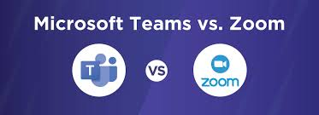
REFERENCES
Zoom Video Communications, Inc.: Corporate website and annual reports.
Microsoft Teams Documentation: Microsoft website and user reviews.
Industry research on video conferencing market trends.
https://www.notta.ai/en/blog
https://zapier.com/blog
https://jatheon.com/blog
https://www.timedoctor.com/blog
https://www.distilnfo.com/
https://www.geeksforgeeks.org/

Slide 15
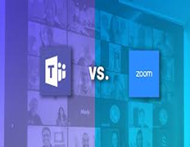


THANKS
Do you have any questions?

